Slide 1
Time Series To infinity and beyond…. by Ralf Martin (r.martin@imperial.ac.uk)

Slide 2
Objectives of this lecture
Time Series data: Different data points represent different points in time
This introduces some additional challenges
We will discuss how to deal with those

Slide 3
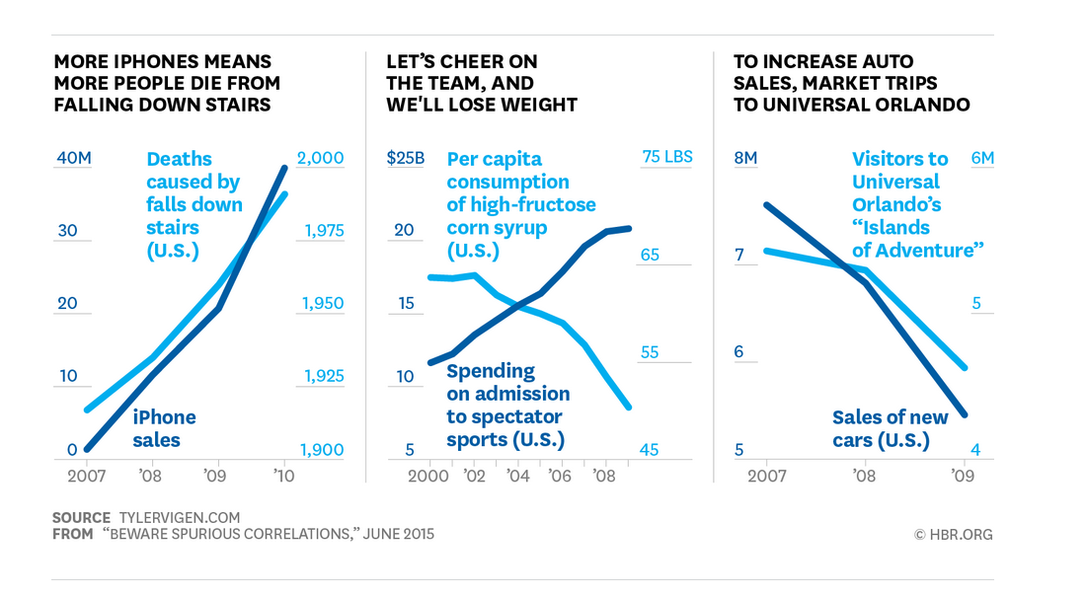
What’s the challenge of time series data?
Can you spot the problem?
Time becomes a confounding variable

Slide 4

Extra Slides

Slide 5
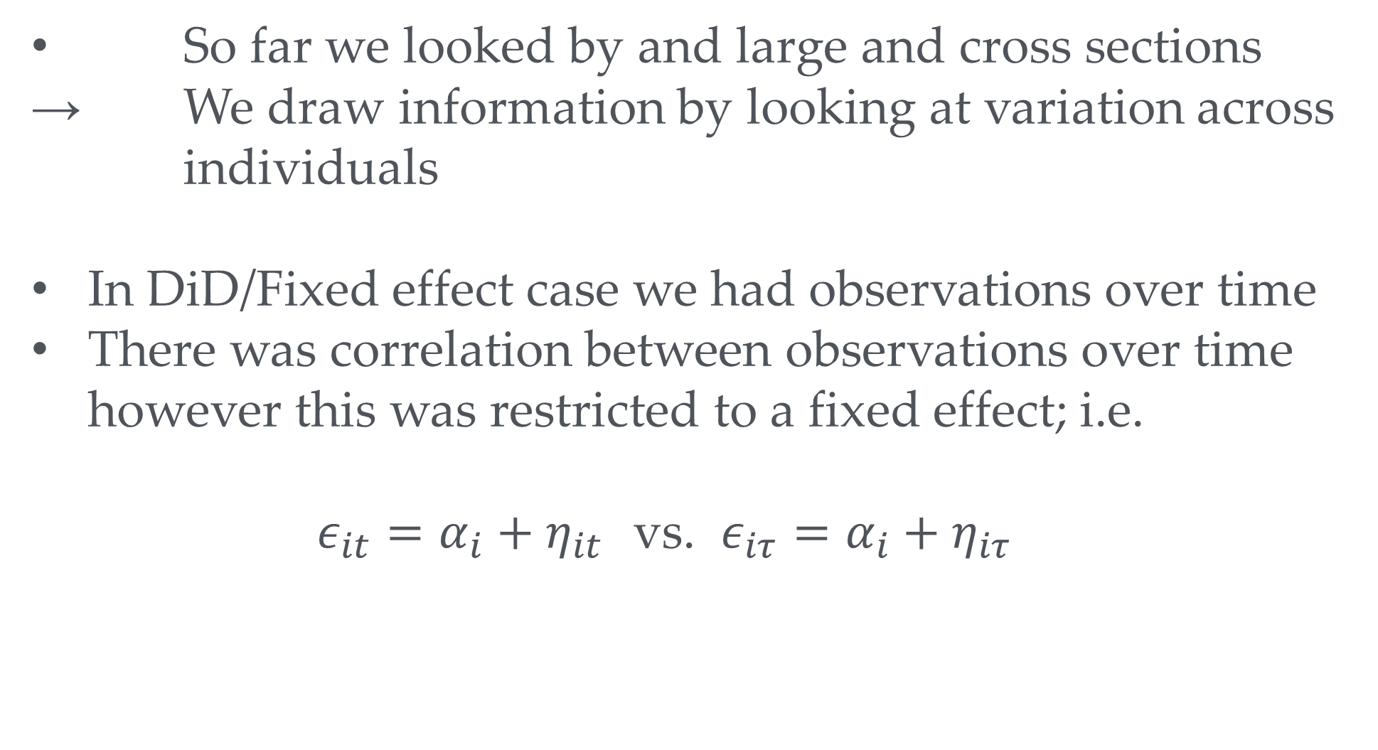
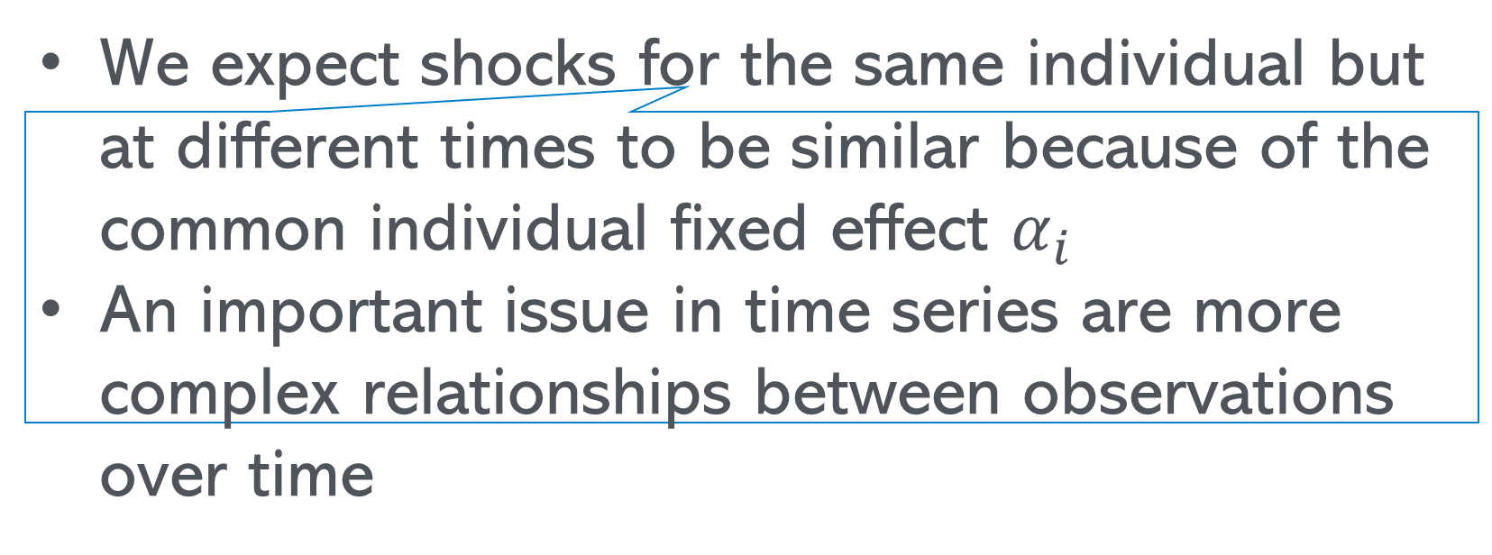
Time series
A bit like: The Complete history of the world in 2 hours
So far we looked by and large and cross sections
→ We draw information by looking at variation across individuals
In DiD/Fixed effect case we had observations over time
There was correlation between observations over time however this was restricted to a fixed effect; i.e.
$ε_{it}=α_{i}+η_{it}$ vs. $ε_{iτ}=α_{i}+η_{iτ}$
We expect shocks for the same individual but at different times to be similar because of the common individual fixed effect $α_{i}$
An important issue in time series are more complex relationships between observations over time

Slide 6

There are many routes to infinity
To get reasonably precise estimates we need large enough samples.
i.e. we make arguments about what happens when samples go to infinity
With panel data we can get large numbers along either of two dimensions:
More cross sectional units
More time periods
Typically we rely more on the cross sectional dimension
In time series we rely on the time dimension which raises additional issue if there is correlation over time
Key concern: stationarity
→ Are the distributional characteristics stable over time?

Slide 7
Time series Example: Japanese GDP

Slide 8
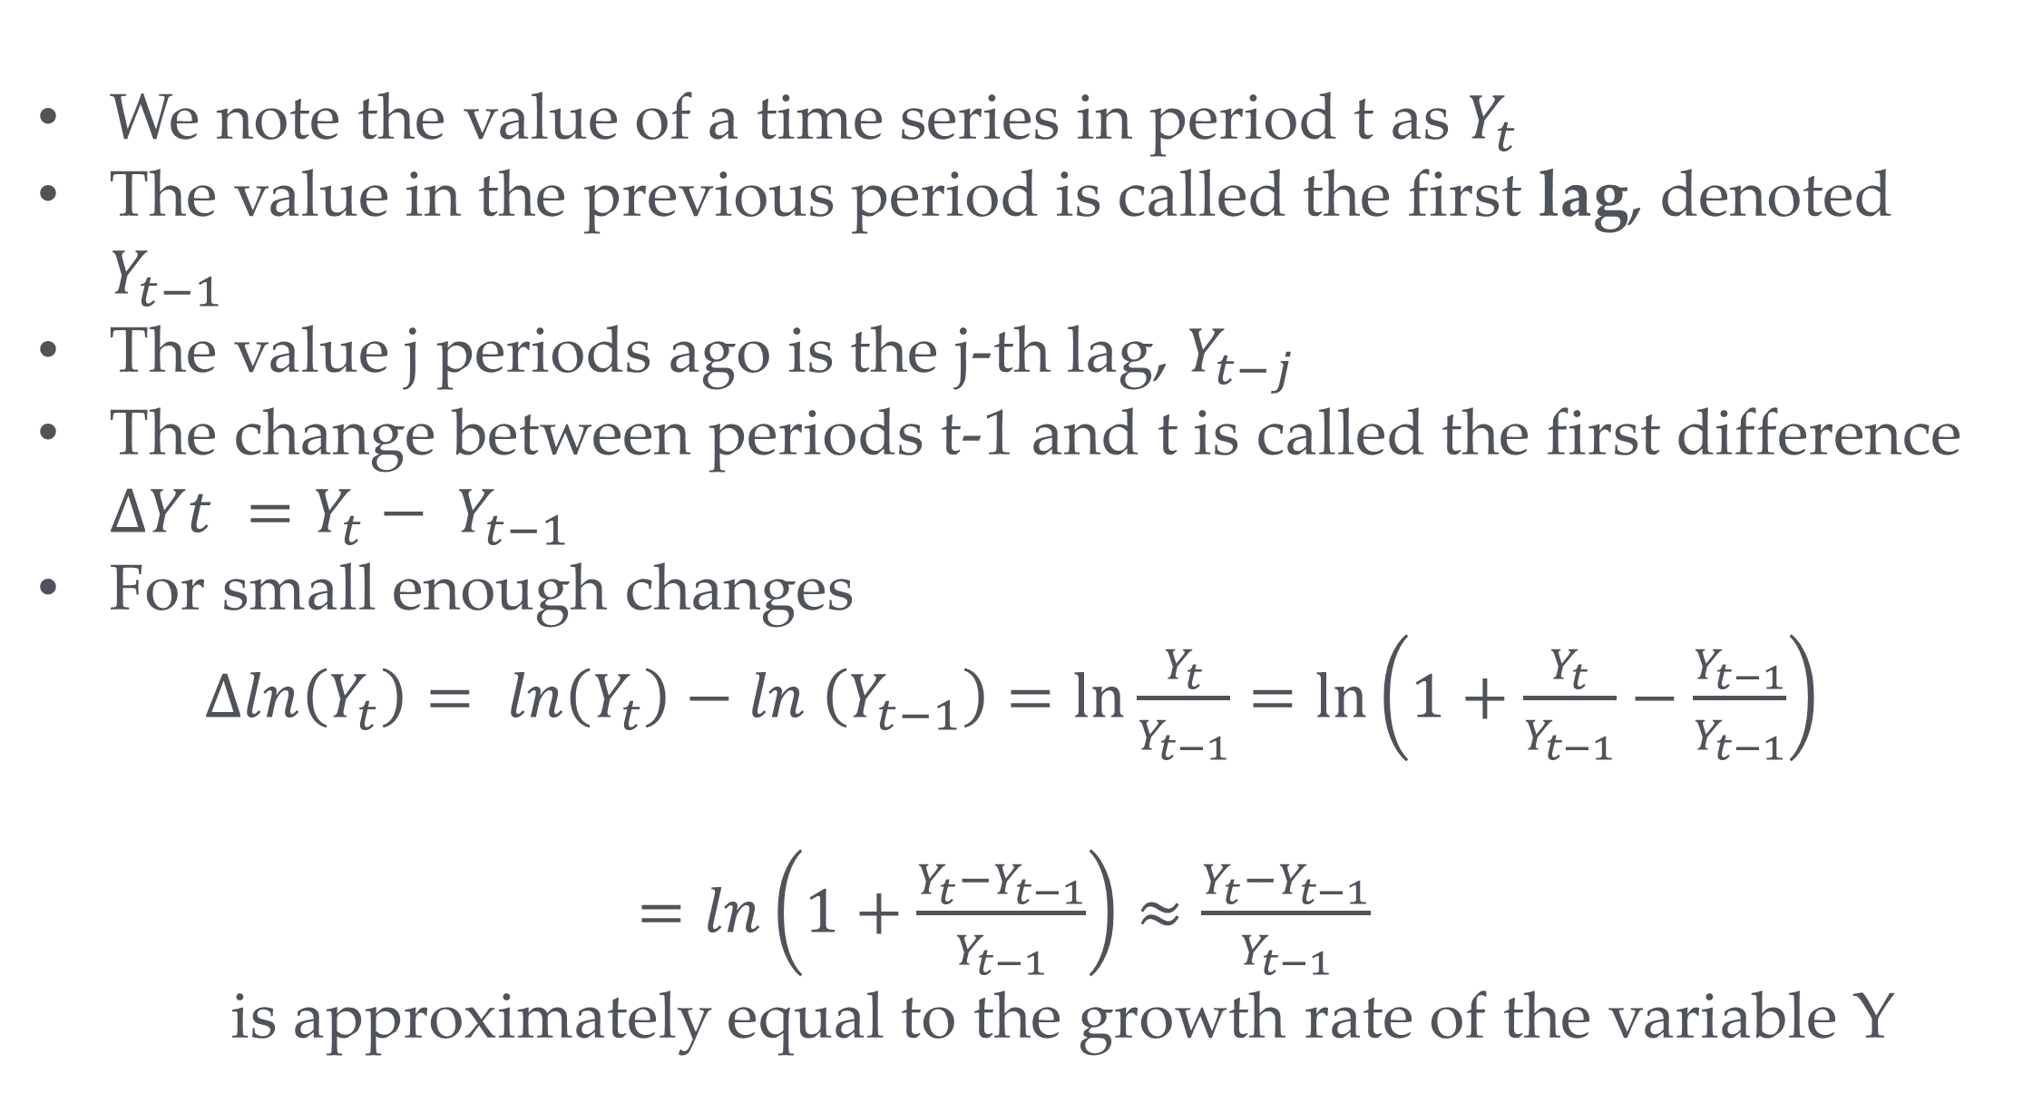
Time series - Notation
We note the value of a time series in period t as $Y_{t}$
The value in the previous period is called the first lag, denoted $Y_{t−1}$
The value j periods ago is the j-th lag, $Y_{t−j}$
The change between periods t-1 and t is called the first difference $∆Yt =Y_{t}− Y_{t−1}$
For small enough changes
$∆ln\left(Y_{t}\right)= ln\left(Y_{t}\right)−ln \left(Y_{t−1}\right)=\ln{\frac{Y_{t}}{Y_{t−1}}=\ln\left(1+\frac{Y_{t}}{Y_{t−1}}−\frac{Y_{t−1}}{Y_{t−1}}\right)}$
$=ln\left(1+\frac{Y_{t}−Y_{t−1}}{Y_{t−1}}\right)≈\frac{Y_{t}−Y_{t−1}}{Y_{t−1}}$
is approximately equal to the growth rate of the variable Y

Slide 9
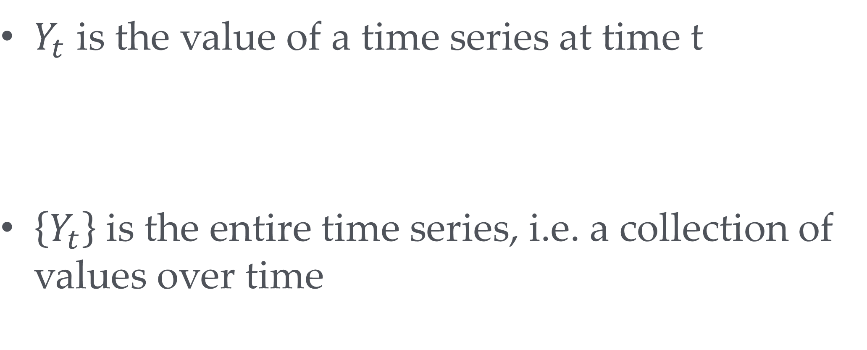
Time series - Notation
$Y_{t}$ is the value of a time series at time t
$\left\{Y_{t}\right\}$is the entire time series, i.e. a collection of values over time

Slide 10
log(Japanese GDP)

Slide 11
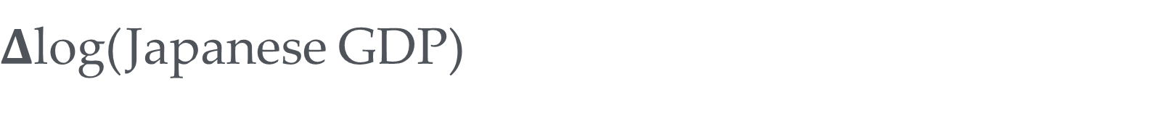
$Δ$log(Japanese GDP)

Slide 12
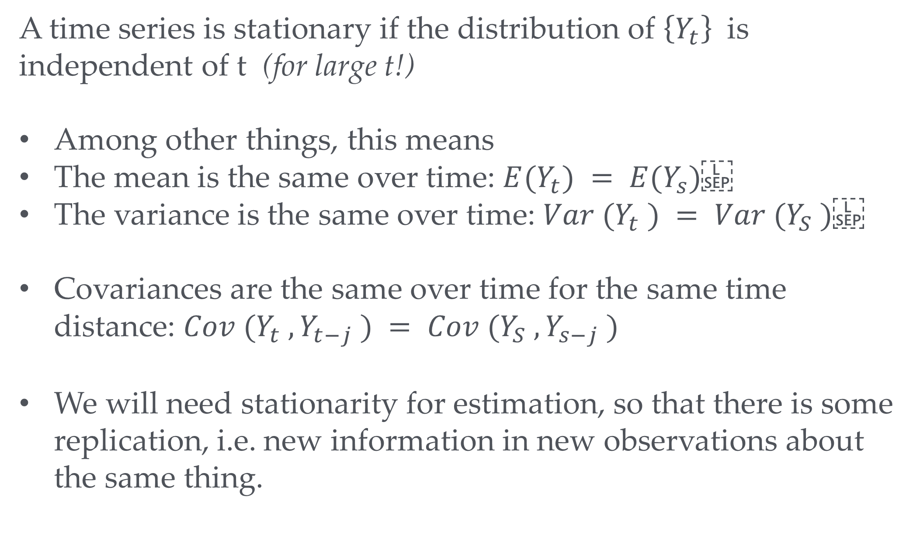
Stationarity Definition
A time series is stationary if the distribution of $\left\{Y_{t}\right\}$ is independent of t (for large t!)
Among other things, this means
The mean is the same over time: $E(Y_{t}) = E(Y_{s})$
The variance is the same over time: $Var (Y_{t} ) = Var (Y_{S} )$
Covariances are the same over time for the same time distance: $Cov (Y_{t} , Y_{t−j} ) = Cov (Y_{S} , Y_{s−j} )$
We will need stationarity for estimation, so that there is some replication, i.e. new information in new observations about the same thing.

Slide 13
To be stationary or not to be stationary – that is the question…..
This one looks clearly non stationary
Your turn: How about this one?

Slide 14
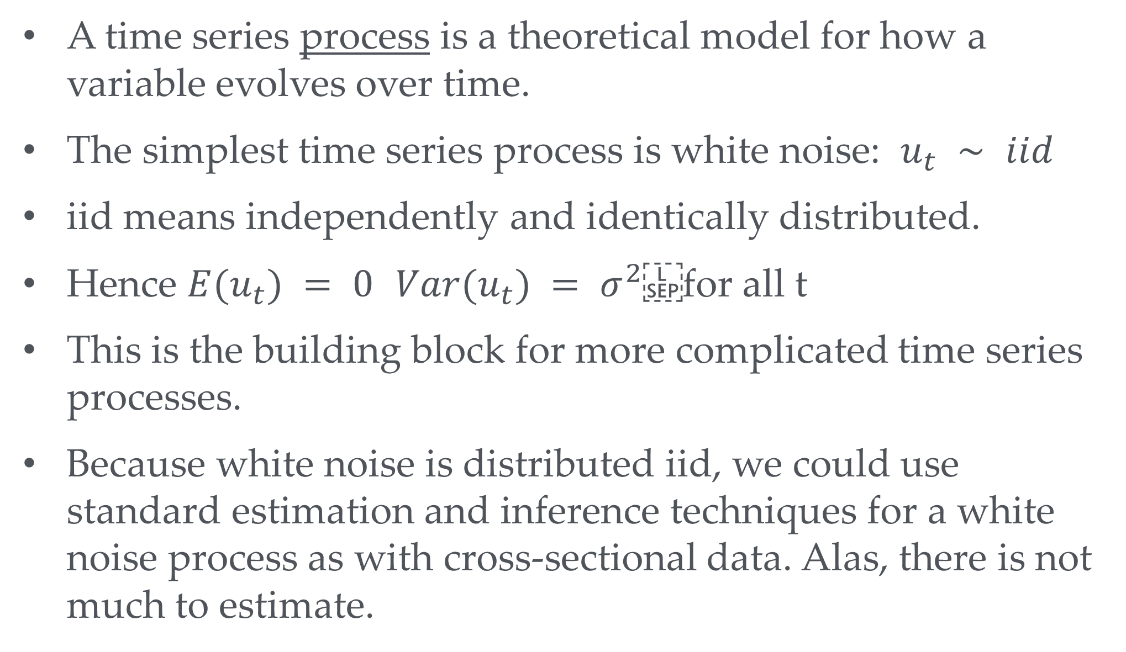
White noise
A time series process is a theoretical model for how a variable evolves over time.
The simplest time series process is white noise: $u_{t} ∼ iid$
iid means independently and identically distributed.
Hence $E(u_{t}) = 0$ $Var(u_{t}) = σ^{2}$ for all t
This is the building block for more complicated time series processes.
Because white noise is distributed iid, we could use standard estimation and inference techniques for a white noise process as with cross-sectional data. Alas, there is not much to estimate.

Slide 15
White noise

Slide 16
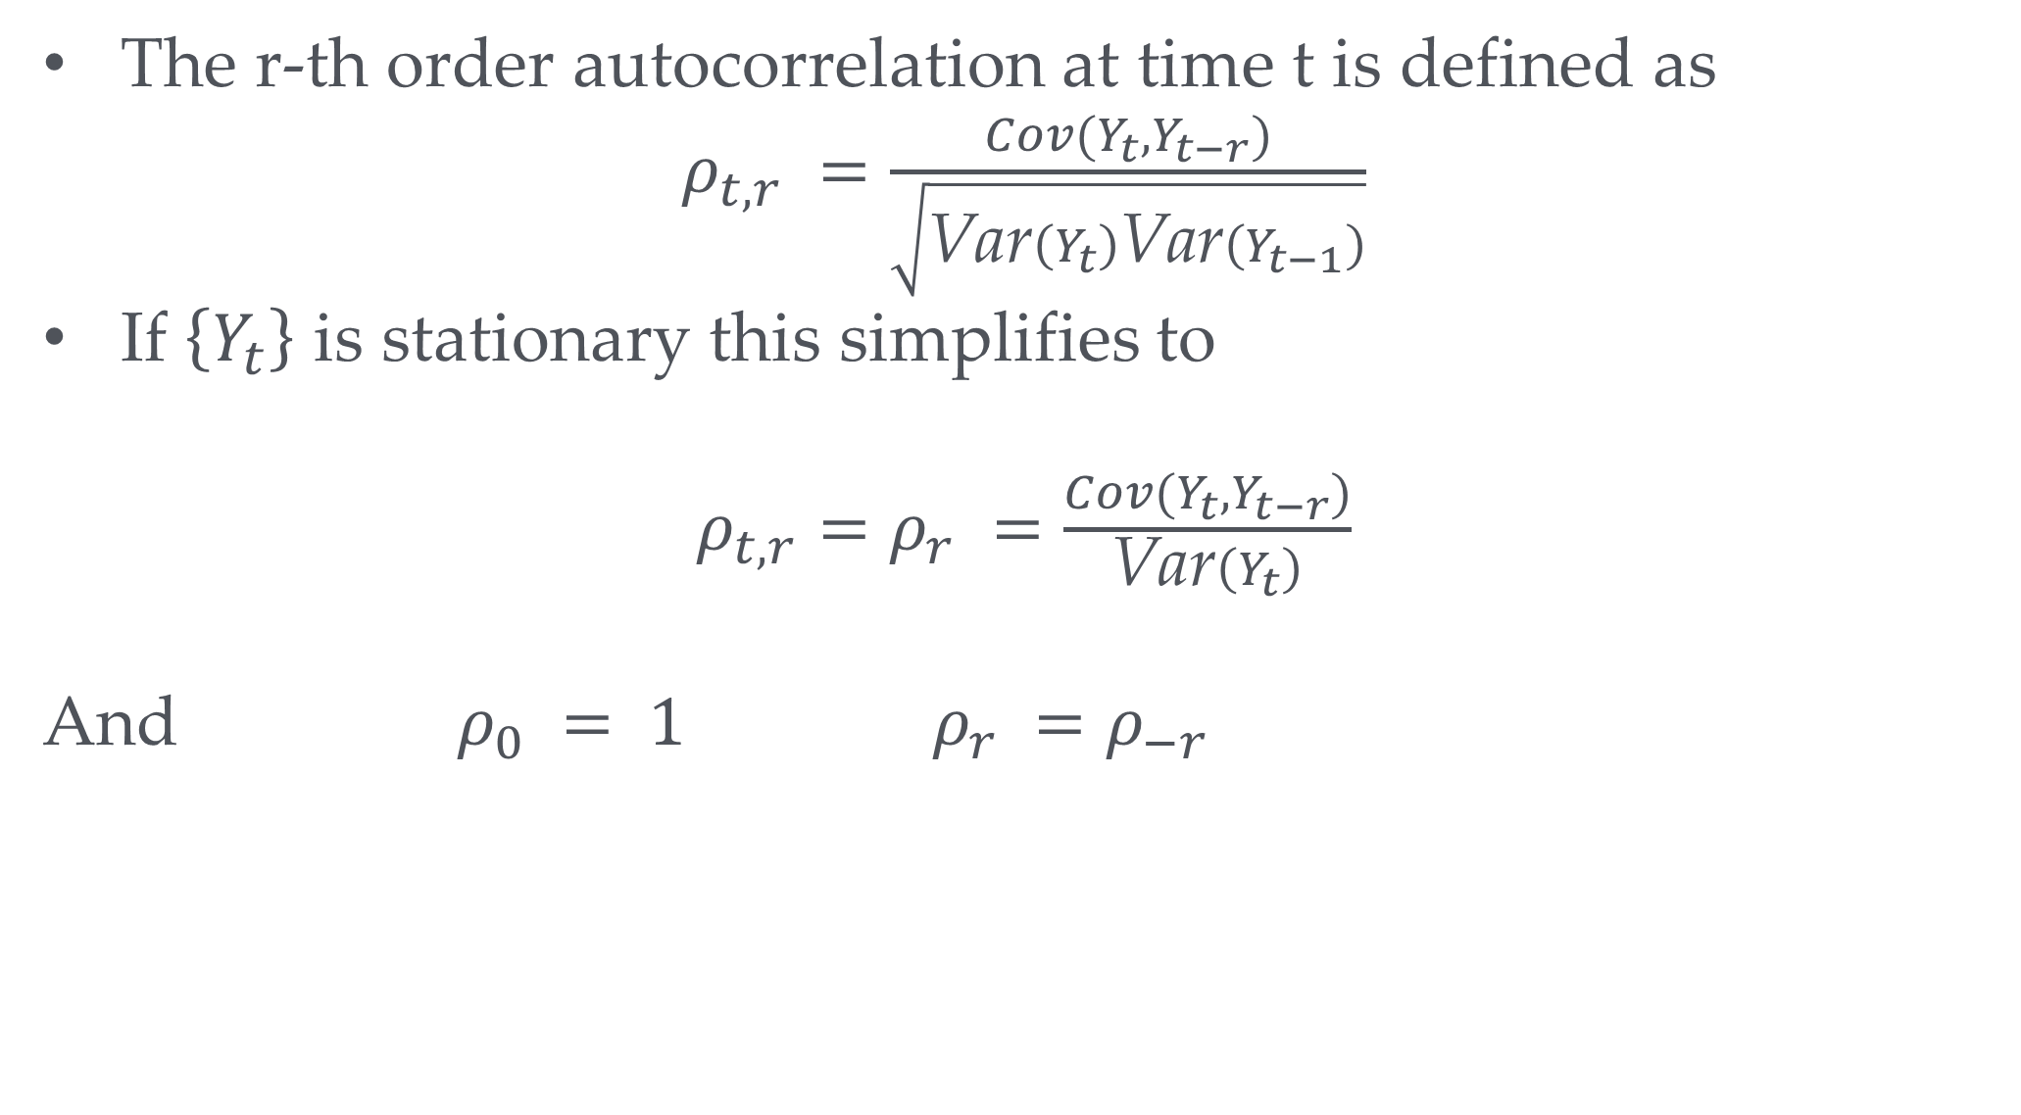
The autocorrelation function
The r-th order autocorrelation at time t is defined as
$ρ_{t,r} =\frac{Cov(Y_{t},Y_{t−r})}{\sqrt{\text{Var}\left(Y_{t}\right)\text{Var}\left(Y_{t−1}\right)}}$
If $\left\{Y_{t}\right\}$ is stationary this simplifies to
$ρ_{t,r}=ρ_{r} =\frac{Cov(Y_{t},Y_{t−r})}{\text{Var}\left(Y_{t}\right)}$
And $ρ_{0} = 1 ρ_{r} =ρ_{−r}$
Your turn: What’s the autocorrelation function for white noise?

Slide 17
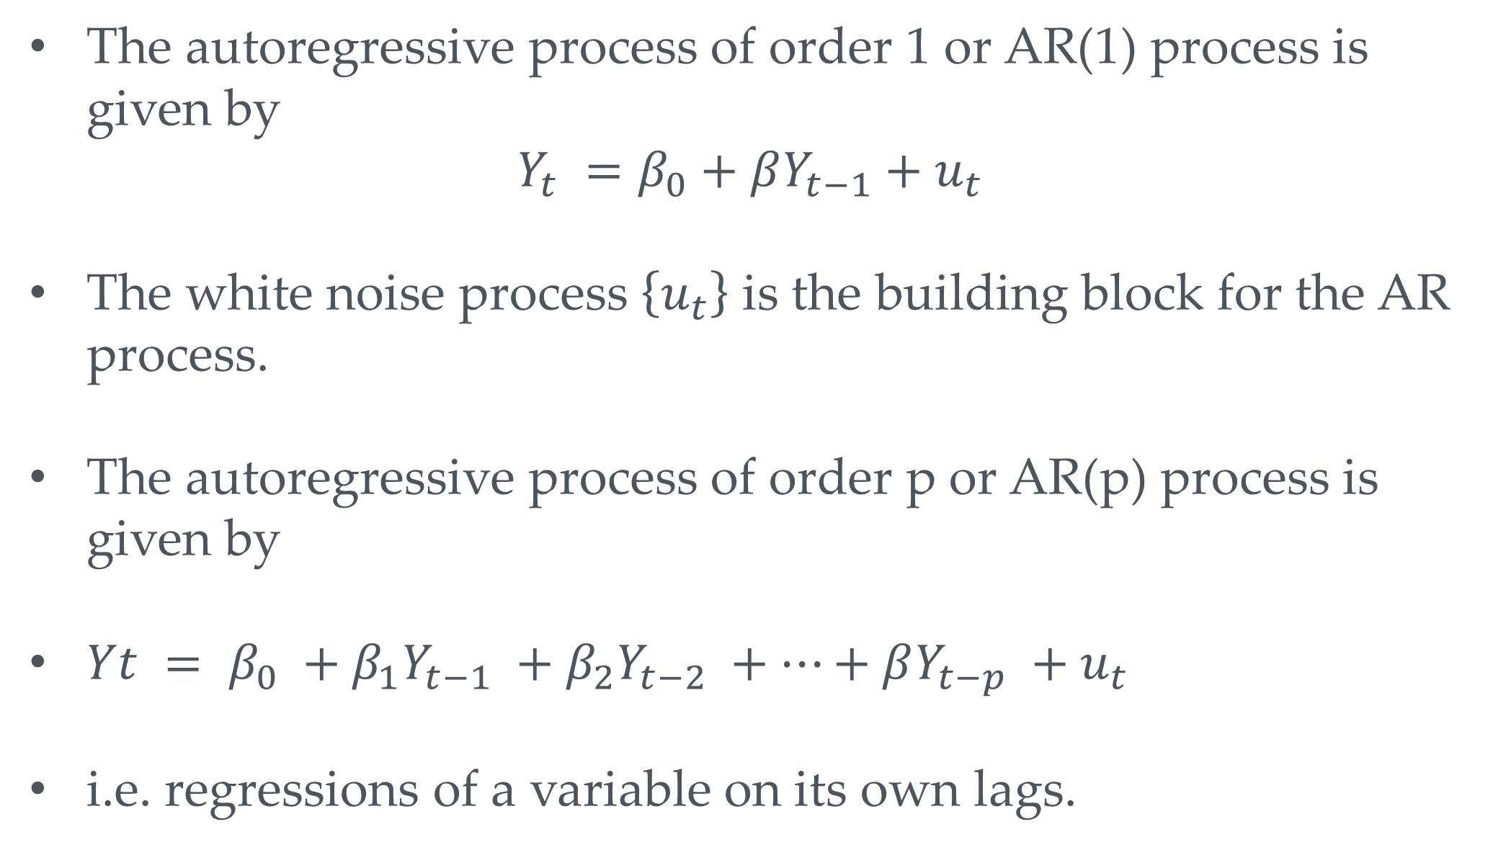
An autoregressive process
The autoregressive process of order 1 or AR(1) process is given by
$Y_{t} =β_{0}+βY_{t−1}+u_{t}$
The white noise process $\left\{u_{t}\right\}$ is the building block for the AR process.
The autoregressive process of order p or AR(p) process is given by
$Yt = β_{0} +β_{1}Y_{t−1} +β_{2}Y_{t−2} +…+βY_{t−p} +u_{t}$
i.e. regressions of a variable on its own lags.

Slide 18
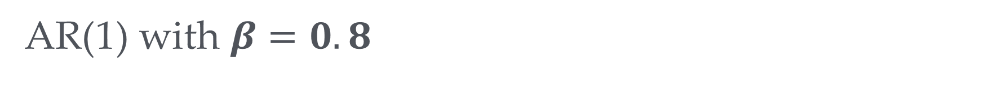
AR(1) with $β=0.8$

Slide 19
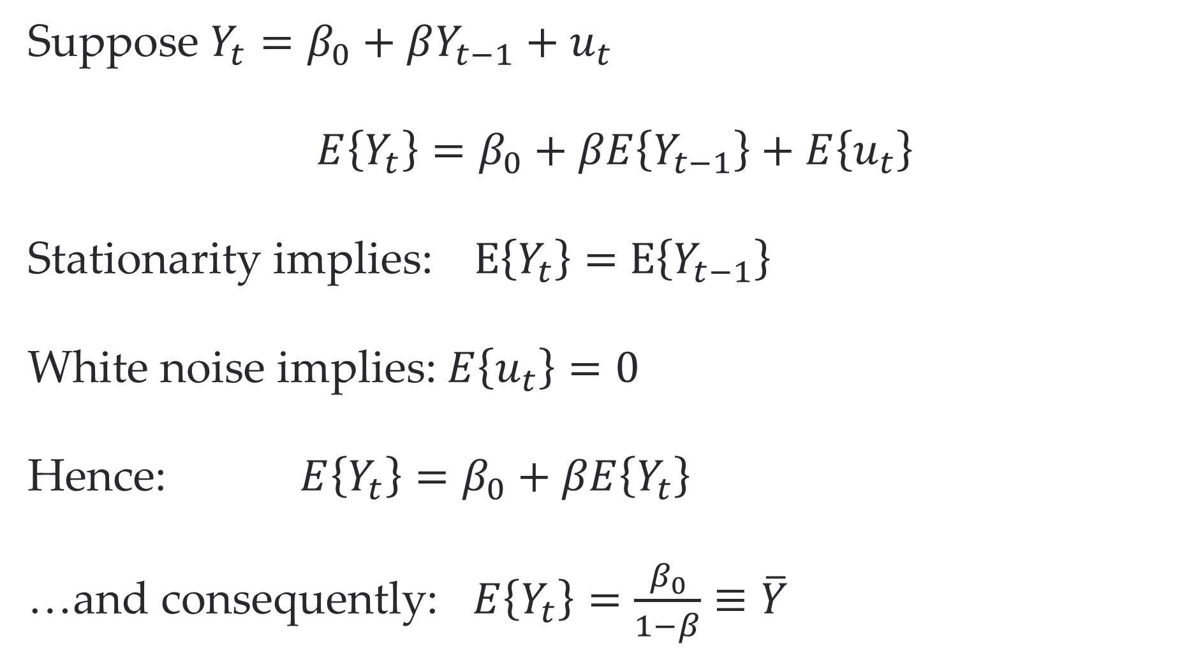
The mean of a stationary AR(1) process
Suppose $Y_{t}=β_{0}+βY_{t−1}+u_{t}$
$$E\left\{Y_{t}\right\}=β_{0}+βE\left\{Y_{t−1}\right\}+E\left\{u_{t}\right\}$$
Stationarity implies: $E\left\{Y_{t}\right\}=$ $E\left\{Y_{t−1}\right\}$
White noise implies: $E\left\{u_{t}\right\}=0$
Hence: $E\left\{Y_{t}\right\}=β_{0}+βE\left\{Y_{t}\right\}$
…and consequently: $E\left\{Y_{t}\right\}=\frac{β_{0}}{1−β}≡\overline{Y}$

Slide 20
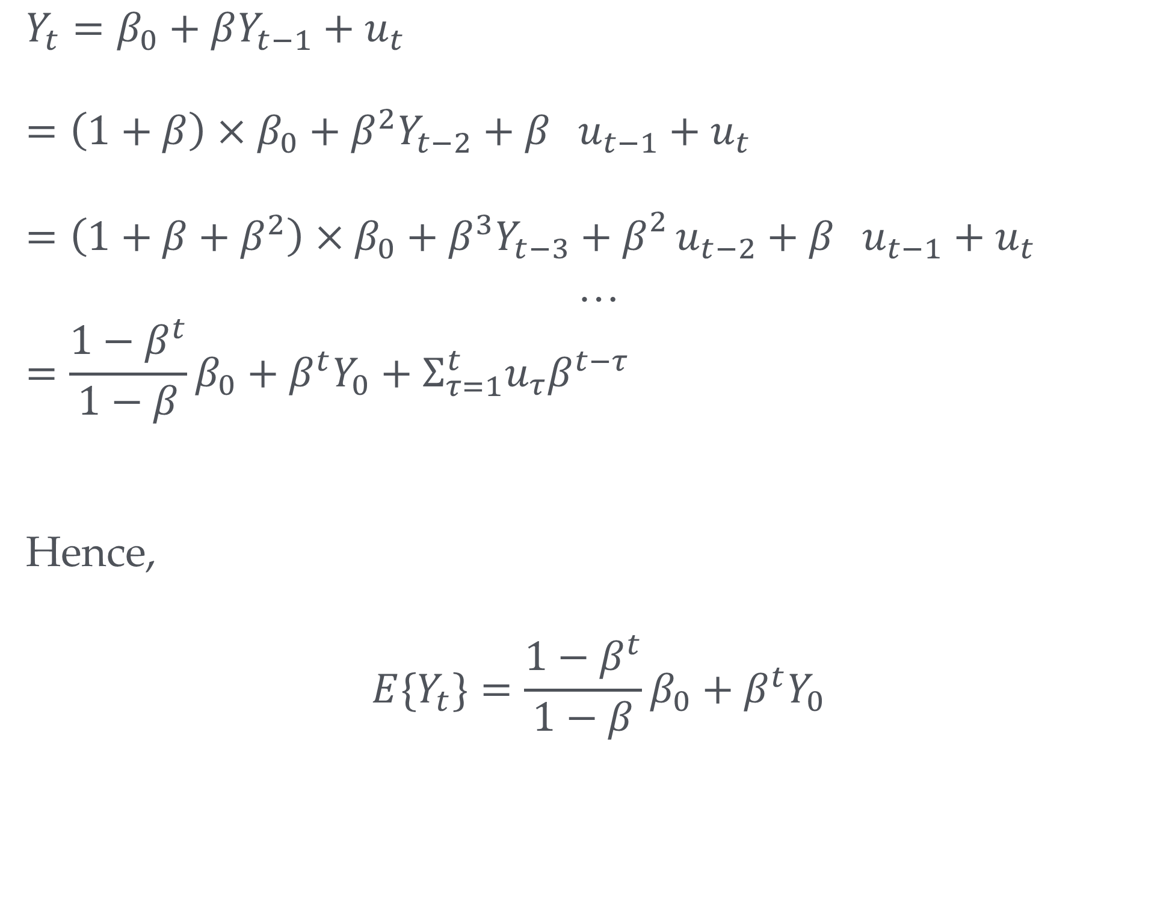
AR(1)
$$Y_{t}=β_{0}+βY_{t−1}+u_{t}$$
$$=\left(1+β\right)×β_{0}+β^{2}Y_{t−2}+β_{}u_{t−1}+u_{t}$$
$$=\left(1+β+β^{2}\right)×β_{0}+β^{3}Y_{t−3}+β_{}^{2}u_{t−2}+β_{}u_{t−1}+u_{t}$$
…
$$=\frac{1−β^{t}}{1−β}{β_{0}+β}^{t}Y_{0}+Σ_{τ=1}^{t}u_{τ}β^{t−τ}$$
Hence,
$$E\{Y_{t}\}=\frac{1−β^{t}}{1−β}{β_{0}+β}^{t}Y_{0}$$
Your turn: Will this be stationary?

Slide 21

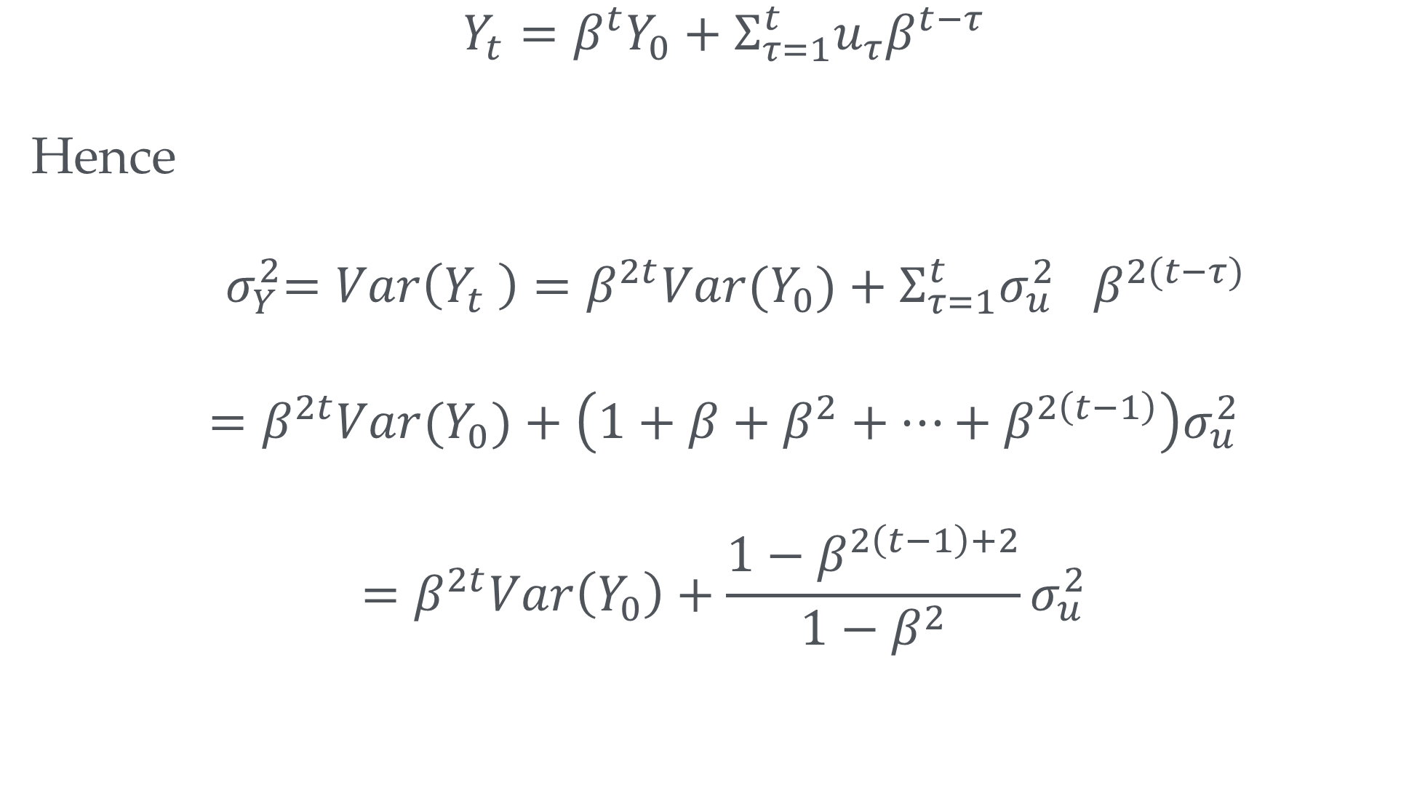
What about${ σ}_{Y}^{2}$?
$$Y_{t}=β^{t}Y_{0}+Σ_{τ=1}^{t}u_{τ}β^{t−τ}$$
Hence
$${ σ}_{Y}^{2}=Var\left(Y_{t} \right)=β^{2t}Var(Y_{0})+Σ_{τ=1}^{t}{σ_{u}^{2}}_{}β^{2(t−τ)}$$
$$=β^{2t}Var(Y_{0})+\left(1+β+β^{2}+…+β^{2\left(t−1\right)}\right)σ_{u}^{2}$$
$$=β^{2t}Var\left(Y_{0}\right)+\frac{1−β^{2\left(t−1\right)+2}}{1−β^{2}}σ_{u}^{2}$$

Slide 22
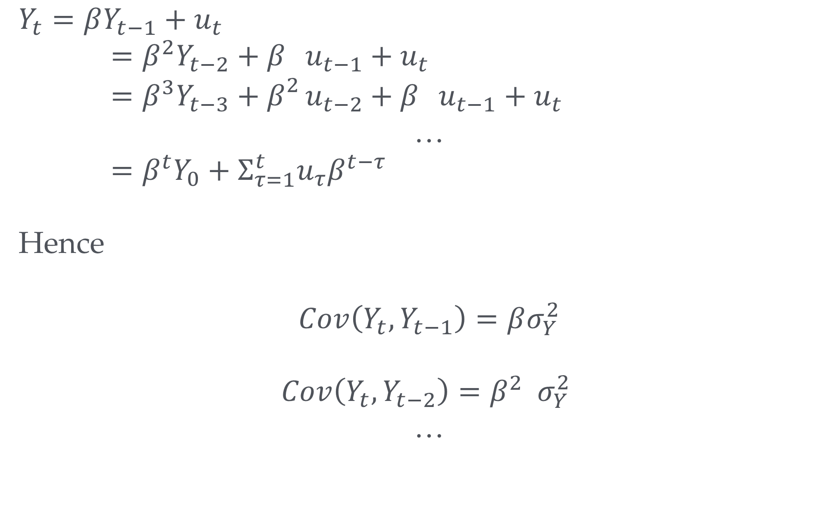
AR(1)
$$Y_{t}=βY_{t−1}+u_{t}$$
$=β^{2}Y_{t−2}+β_{}u_{t−1}+u_{t}$
$=β^{3}Y_{t−3}+β_{}^{2}u_{t−2}+β_{}u_{t−1}+u_{t}$
…
$=β^{t}Y_{0}+Σ_{τ=1}^{t}u_{τ}β^{t−τ}$
Hence
$$Cov\left(Y_{t},Y_{t−1}\right)=βσ_{Y}^{2}$$
$$Cov\left(Y_{t},Y_{t−2}\right)=β^{2}{ σ}_{Y}^{2}$$
…

Slide 23
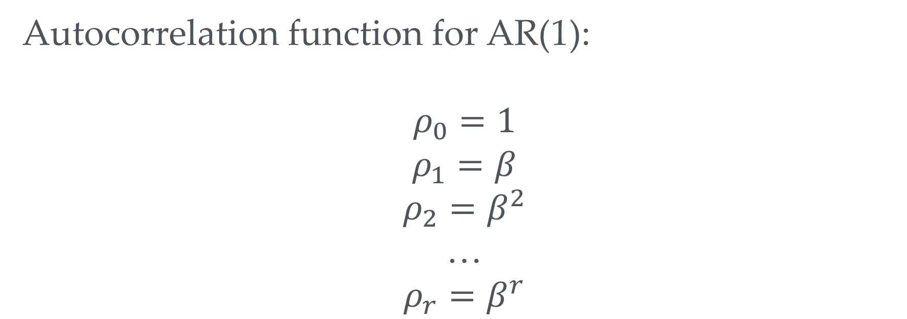
Autocorrelation function of AR(1)
Autocorrelation function for AR(1):
$$ρ_{0}=1$$
$$ρ_{1}=β$$
$$ρ_{2}=β^{2}$$
…
$$ρ_{r}=β^{r}$$
i.e. the further away two observations are in time the less correlated they will be

Slide 24

Correlogram of AR(1) with $β=0.8$

Slide 25

Correlogram of AR(1) with $β=−0.7$

Slide 26
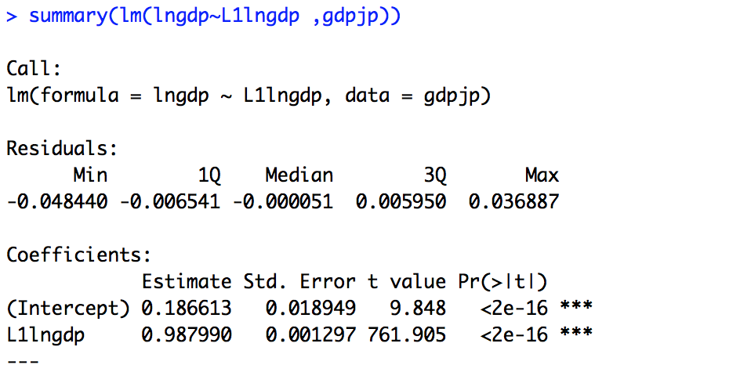
Estimation of a stationary model
library(haven)
gdpjp <-read_dta("data/gdp_JP.dta")
library(quantmod)
gdpjp <-read_dta("data/gdp_JP_etc.dta") gdpjp["L1lngdp"]=Lag(gdpjp$lngdp,1) summary(lm(lngdp~L1lngdp ,gdpjp))

Slide 27
Non – stationarity: a roadmap
Types of non-stationarity:
The random walk
Trend stationary time series
Consequences of non-stationarity:
Autoregressive coefficients are biased and t-statistics have non-normal distributions Spurious regression; e.g. we find a significant relationship just because things grow over time (e.g. height of child and GDP)
Detecting non-stationarity: the Dickey-Fuller test
Unit roots and integration
Making time series stationary: regression in First Differences

Slide 28
Non – stationarity: Trends
Many time series, like Japanese GDP, are trending. Clearly, these time series are not stationary.
There are two ways to incorporate trends into a time series model:
Deterministic trends: this is simply a non-random function of time. For example, output capacity may grow at a constant rate over time but GDP may fluctuate around the trend produced by output capacity.
Stochastic trends: in this case the trend is random itself. There may be prolonged periods of increase and prolonged periods of decrease.
There are many other forms non-stationarity can take (which we will not discuss here); e.g. breaks in mean or trend, changes in variance over time ...

Slide 29
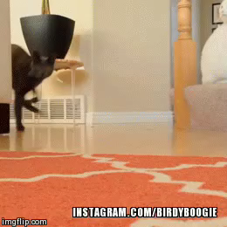
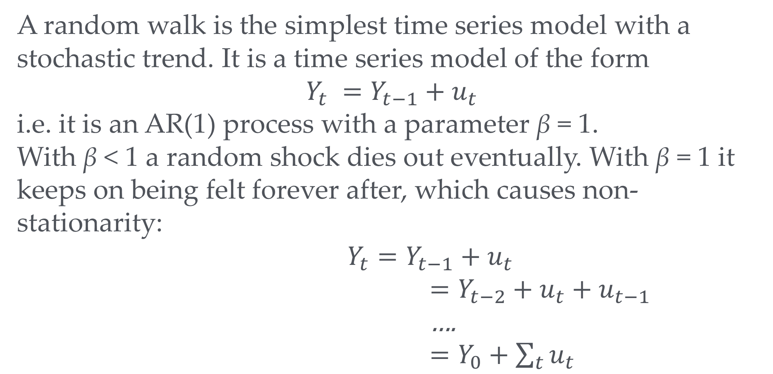
Random Walks
A random walk is the simplest time series model with a stochastic trend. It is a time series model of the form
$$Y_{t} =Y_{t−1}+u_{t}$$
i.e. it is an AR(1) process with a parameter β = 1.
With β < 1 a random shock dies out eventually. With β = 1 it keeps on being felt forever after, which causes non-stationarity:
$Y_{t}=Y_{t−1}+u_{t}$
$=Y_{t−2}+u_{t}+u_{t−1}$
….
$=Y_{0}+\sum_{t}{u_{t}}$
i.e. random walk adds up all shocks from the past of the process

Slide 30
A Random Walk

Slide 31
Two different Random Walks

Slide 32

A Random Walk and an AR(1) with $β=0.95$
i.e. even if a series’ formula almost looks like random walk it behaves very differntly

Slide 33
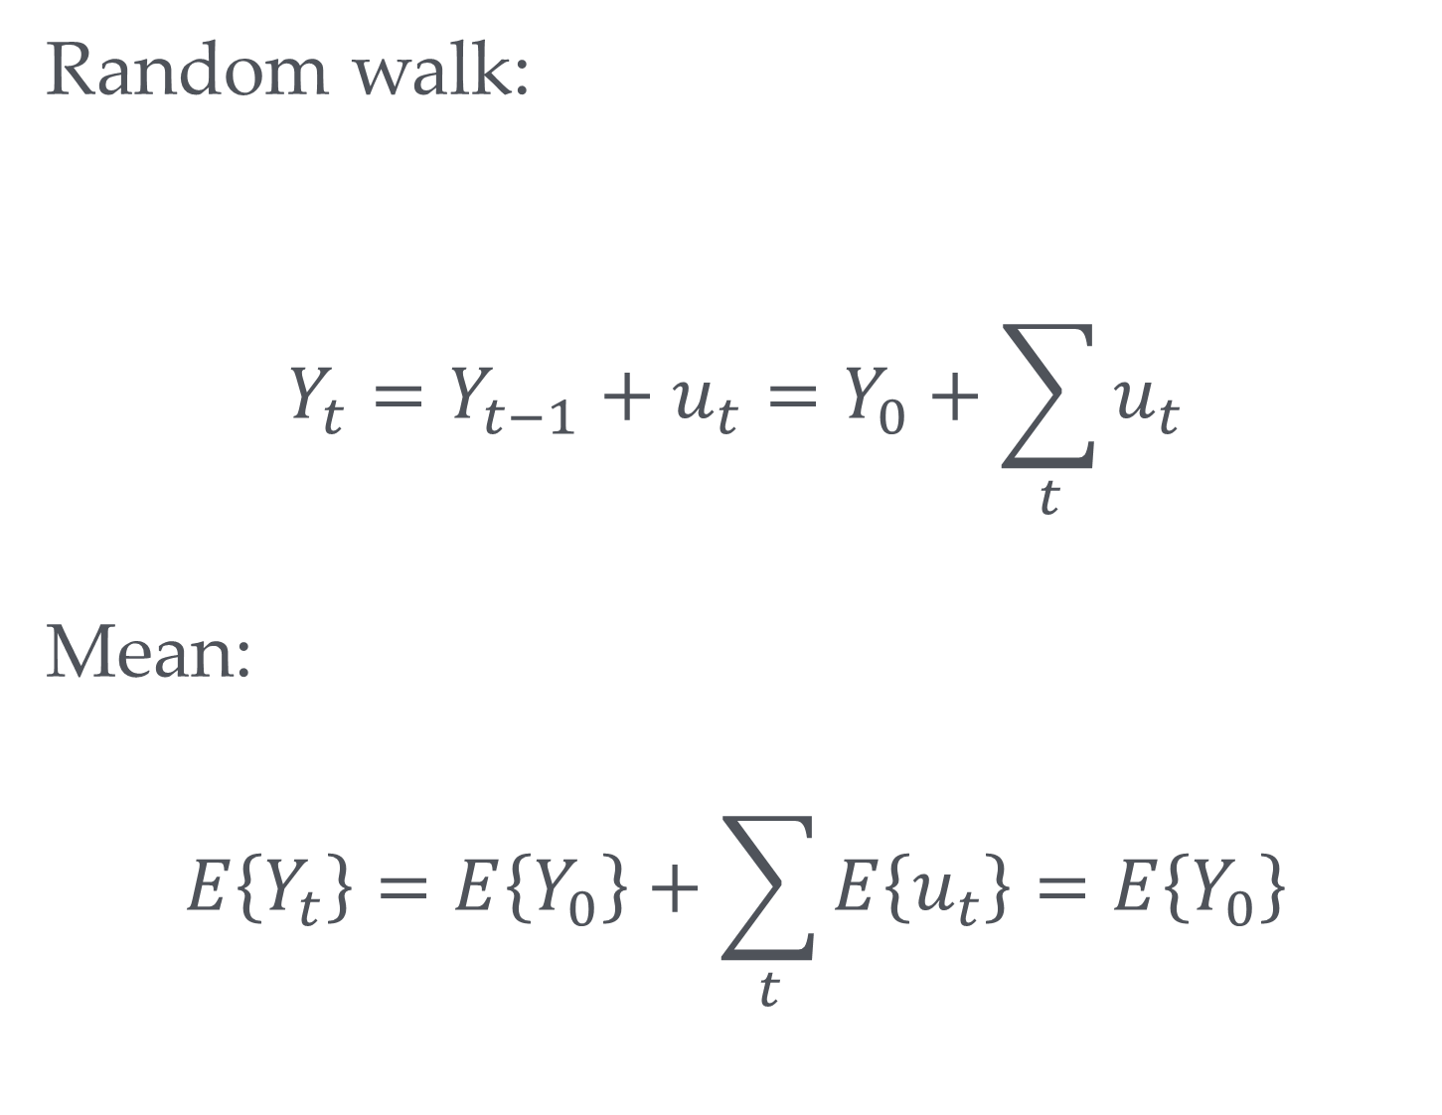
Mean of a random walk
Random walk:
$$Y_{t}=Y_{t−1}+u_{t}=Y_{0}+\sum_{t}{u_{t}}$$
Mean:
$$E\left\{Y_{t}\right\}=E\left\{Y_{0}\right\}+\sum_{t}{E\left\{u_{t}\right\}}=E\left\{Y_{0}\right\}$$
i.e. this does not change over time…
So is it stationary after all?

Slide 34
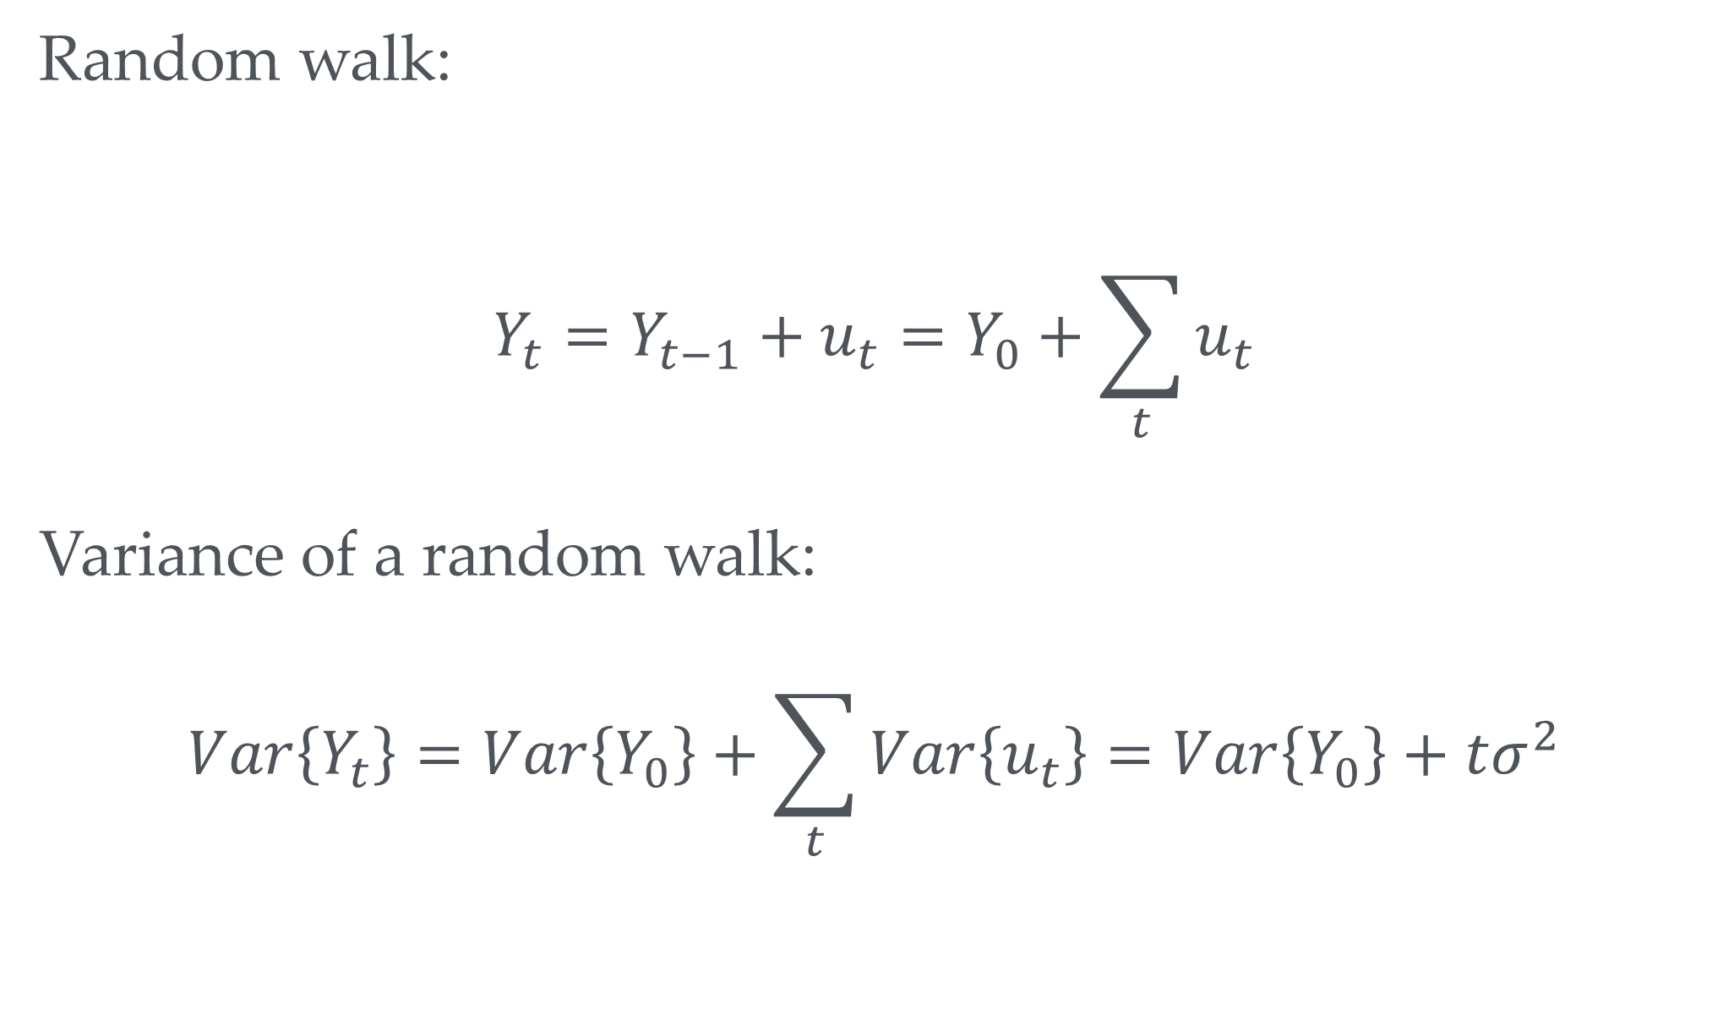
Variance of a random walk
Random walk:
$$Y_{t}=Y_{t−1}+u_{t}=Y_{0}+\sum_{t}{u_{t}}$$
Variance of a random walk:
$$Var\left\{Y_{t}\right\}=Var\left\{Y_{0}\right\}+\sum_{t}{Var\left\{u_{t}\right\}}=Var\left\{Y_{0}\right\}+tσ^{2}$$
i.e. grows over time so not stationary

Slide 35
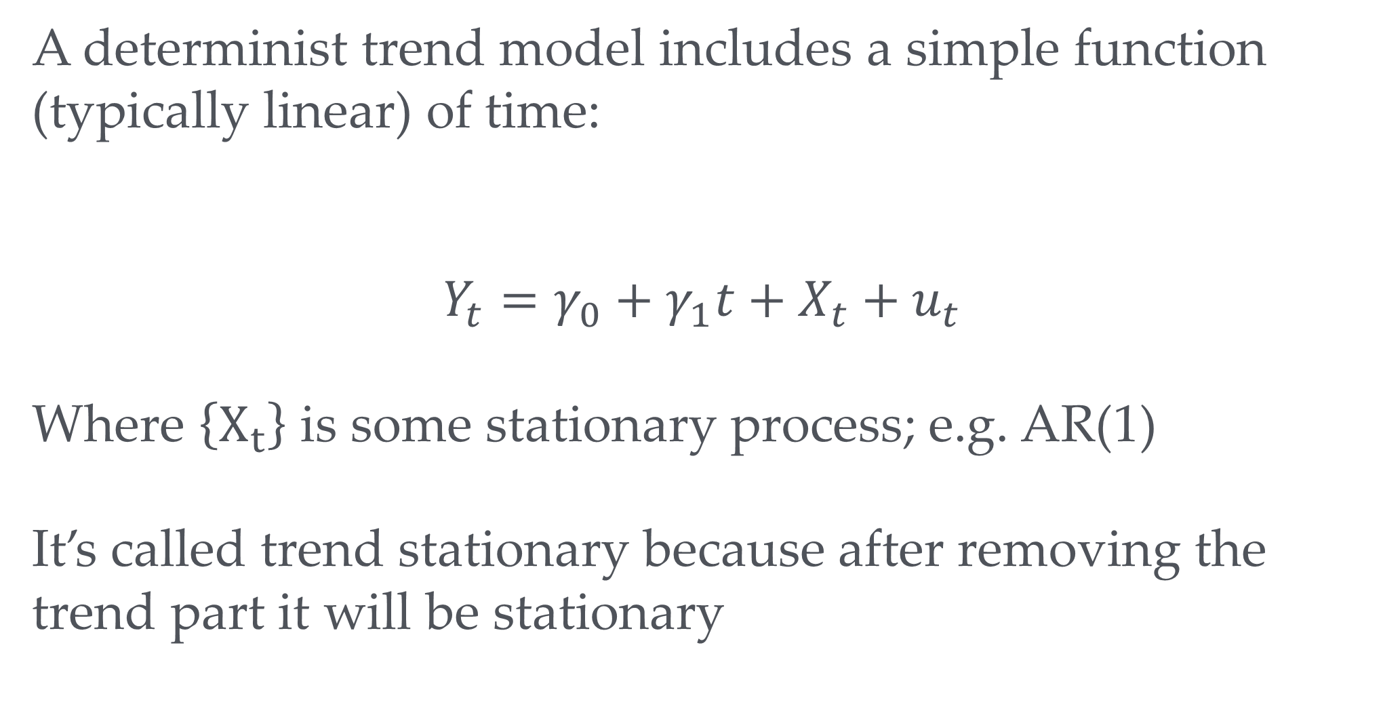
A deterministic trend
A determinist trend model includes a simple function (typically linear) of time:
$$Y_{t}=γ_{0}+γ_{1}t+X_{t}+u_{t}$$
Where $\left\{X_{t}\right\}$ is some stationary process; e.g. AR(1)
It’s called trend stationary because after removing the trend part it will be stationary

Slide 36
A deterministic trend vs random walk
i.e. they can look very similar indeed

Slide 37
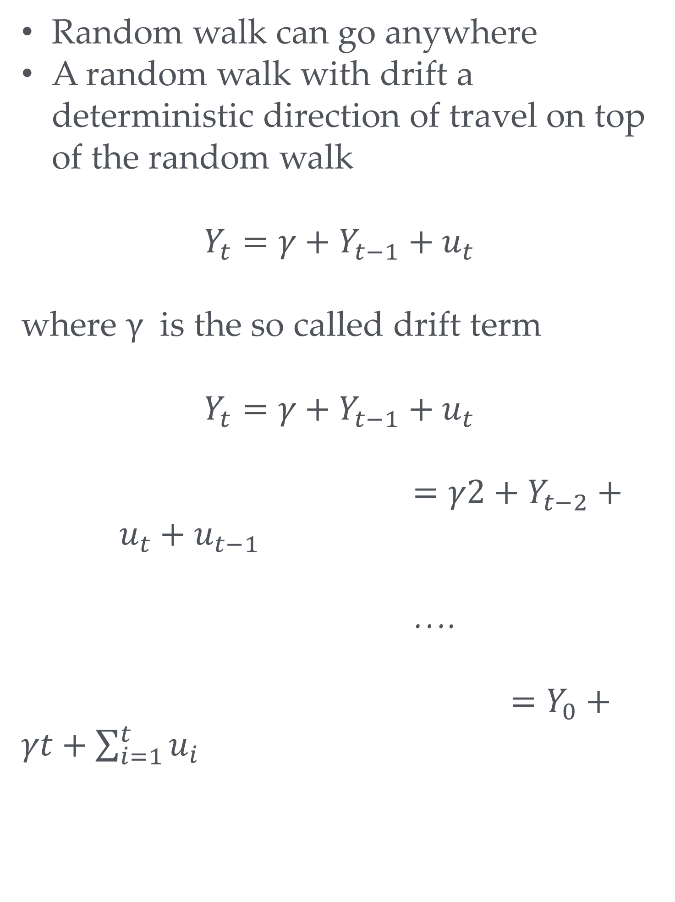
Random walk with drift
Random walk can go anywhere
A random walk with drift a deterministic direction of travel on top of the random walk
$$Y_{t}=γ+Y_{t−1}+u_{t}$$
where $γ$ is the so called drift term
$$Y_{t}=γ+Y_{t−1}+u_{t}$$
$=γ2+Y_{t−2}+u_{t}+u_{t−1}$
….
$=Y_{0}+γt+\sum_{i=1}^{t}{u_{i}}$

Slide 38
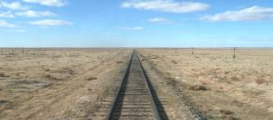
Consequences of non stationarity
Stationary process: Can use OLS (with some adjustments of standard errors). Include lagged dependent variables as regressors; e.g.
Trend stationary: Use OLS and include time trend as explanatory variable
lm(lngdp~L1lngdp+time ,gdpjp)
If we have a random process autoregressive coefficient estimates will be biased and t-statistics don’t converge to normal distribution even in large samples
More on that later

Slide 39
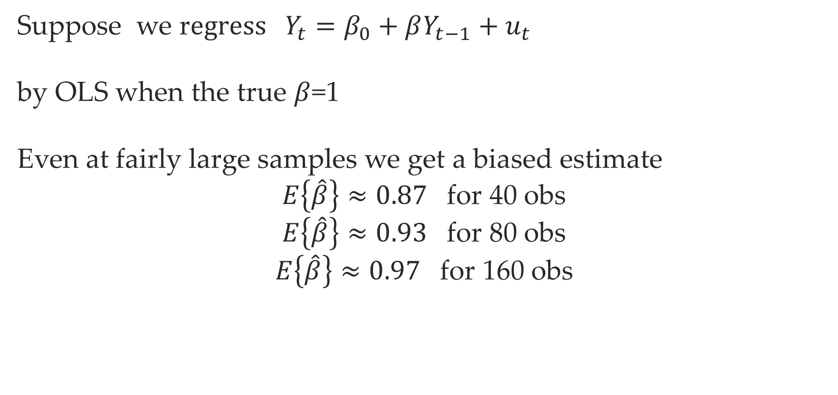
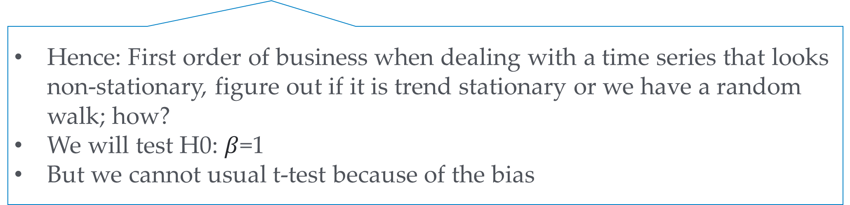
Random walk’s biased estimates
Suppose we r$egress Y_{t}=β_{0}+βY_{t−1}+u_{t}$
by OLS when the true $β$=1
Even at fairly large samples we get a biased estimate
$E\left\{\hat{β}\right\}≈0.87$ for 40 obs
$E\left\{\hat{β}\right\}≈0.93$ for 80 obs
$E\left\{\hat{β}\right\}≈0.97$ for 160 obs
Hence: First order of business when dealing with a time series that looks non-stationary, figure out if it is trend stationary or we have a random walk; how?
We will test H0: $β$=1
But we cannot usual t-test because of the bias

Slide 40
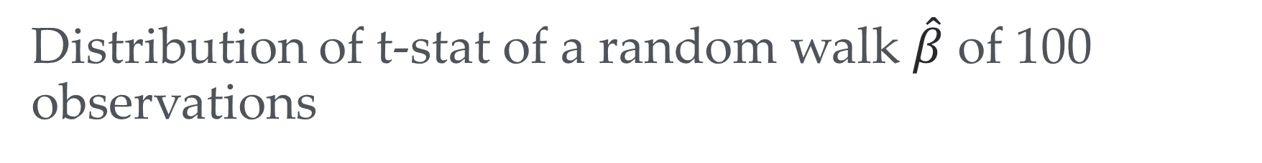
Distribution of t-stat of a random walk $\hat{β}$ of 100 observations

Slide 41
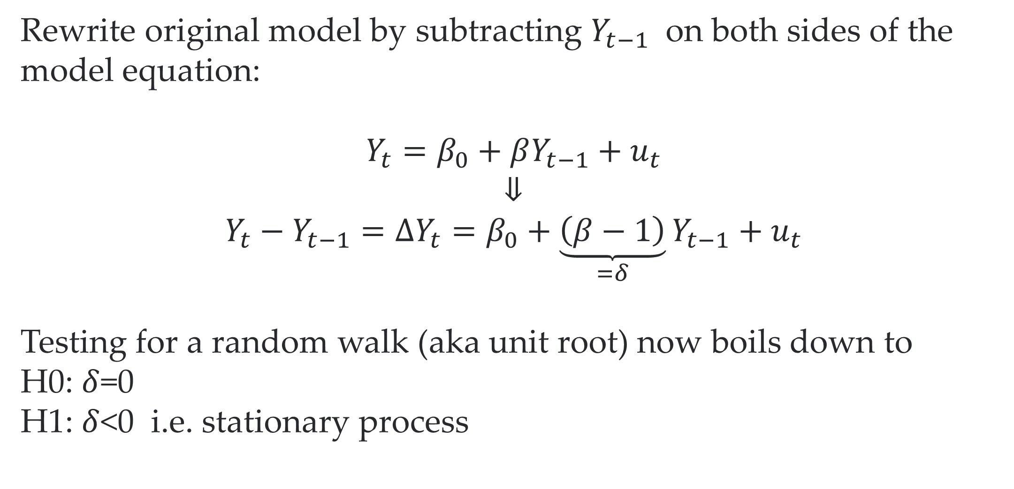
Dickey-Fuller test to the rescue
Rewrite original model by subtracting $Y_{t−1}$ on both sides of the model equation:
$$Y_{t}=β_{0}+βY_{t−1}+u_{t}$$
⇓
$$Y_{t}−Y_{t−1}=ΔY_{t}=β_{0}+\underset{=δ}{\underbrace{\left(β−1\right)}}Y_{t−1}+u_{t}$$
Testing for a random walk (aka unit root) now boils down to
H0: $δ$=0
H1: $δ$<0 i.e. stationary process
We still cannot just compare the implied test statistic to a normal t-table
Luckily R will help us

Slide 42
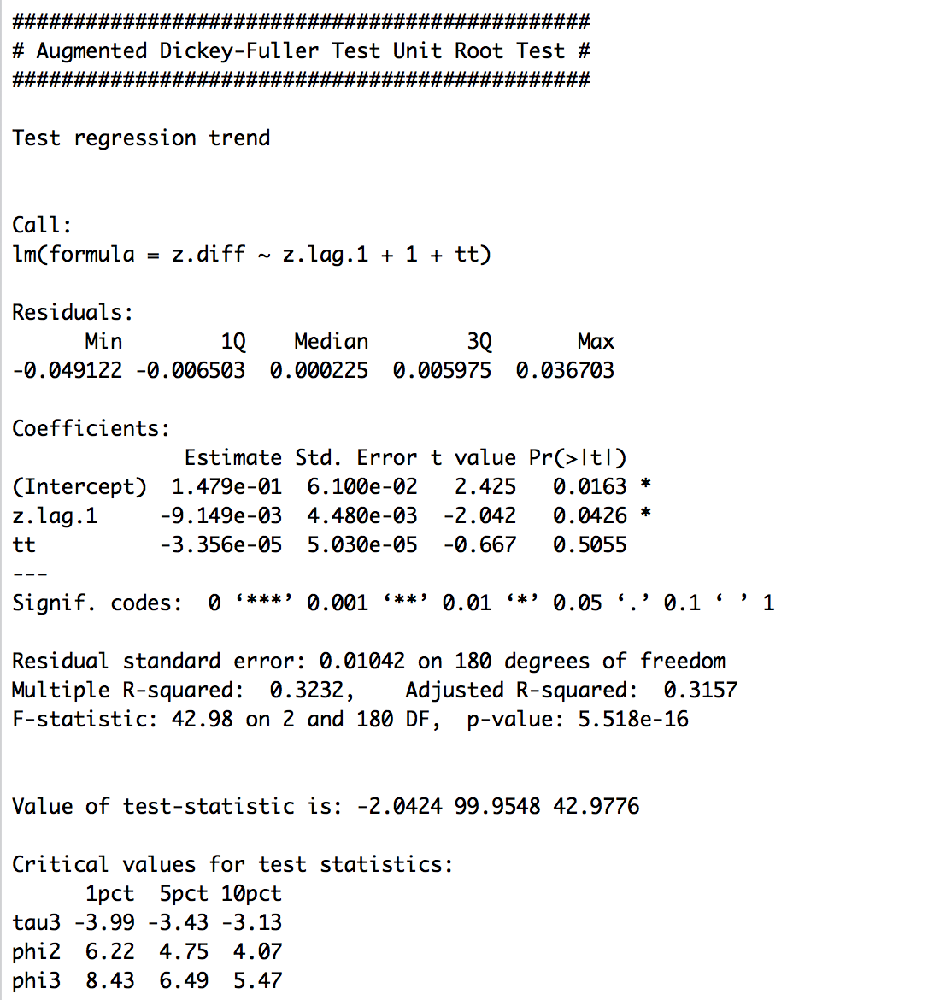
R to the rescue: DF tests
library(urca)
df<-ur.df(gdpjp$lngdp,type="trend",lags=0)
summary(df)
We cannot reject the H0; i.e. we cannot reject that this series is a random walk

Slide 43
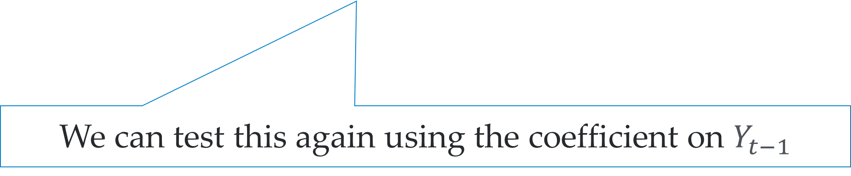
How about AR(2)?
$$Y_{t}−Y_{t−1}=β_{0}+\left(β_{1}+β_{2}−1\right)Y_{t−1}−β_{2}\left(Y_{t−1}−Y_{t−2}\right)+u_{t}$$
We can test this again using the coefficient on $Y_{t−1}$

Slide 44
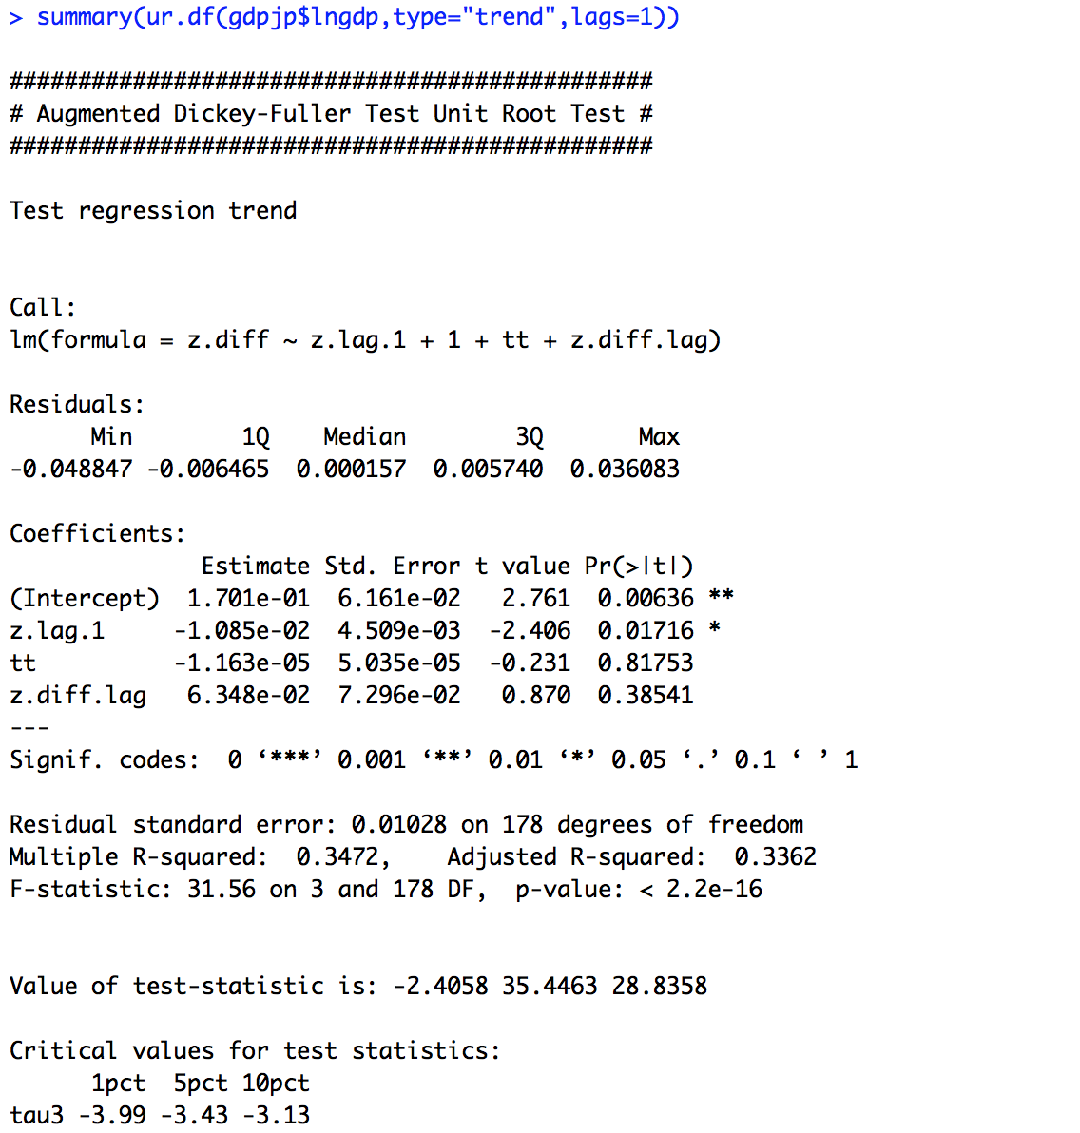
R can do AR(2) too (or more)
How many?
See what is significant or what makes sense based on theory;
E.g. with quarterly we often include a whole year worth of lags (i.e. 4)

Slide 45
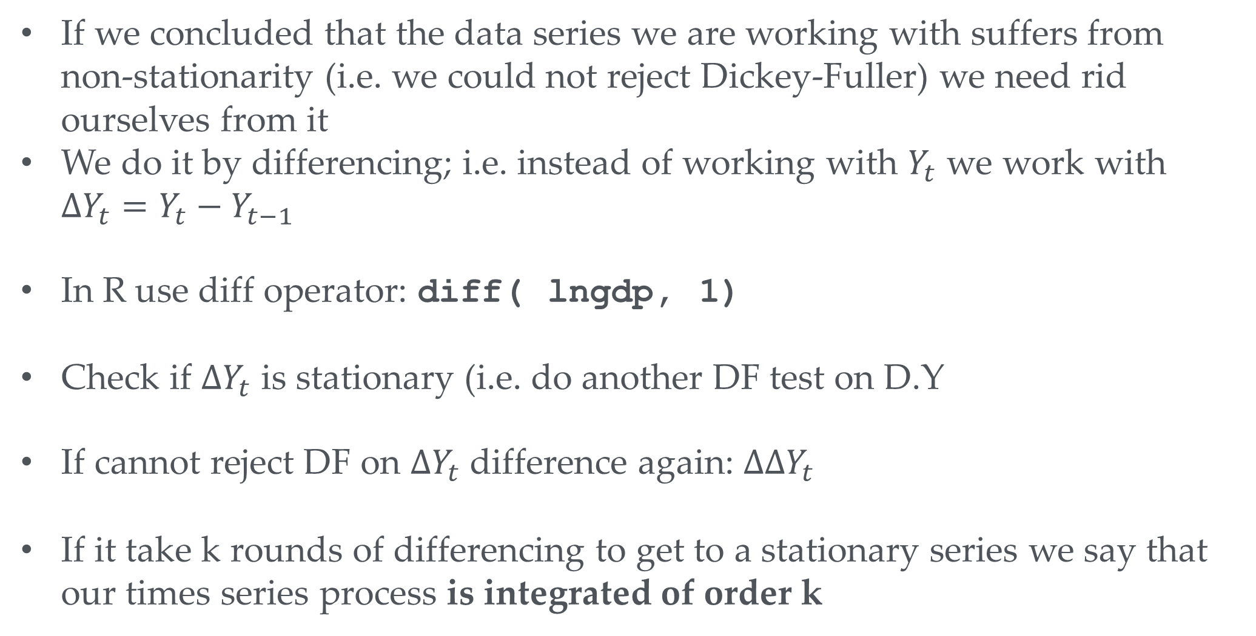
Dealing with non-stationarity
If we concluded that the data series we are working with suffers from non-stationarity (i.e. we could not reject Dickey-Fuller) we need rid ourselves from it
We do it by differencing; i.e. instead of working with $Y_{t}$ we work with ${ΔY}_{t}=Y_{t}−Y_{t−1}$
In R use diff operator: diff( lngdp, 1)
Check if ${ΔY}_{t}$ is stationary (i.e. do another DF test on D.Y
If cannot reject DF on ${ΔY}_{t}$ difference again: ${ΔΔY}_{t}$
If it take k rounds of differencing to get to a stationary series we say that our times series process is integrated of order k
Carry on until you have have a stationary series (i.e. reject DF)

Slide 46
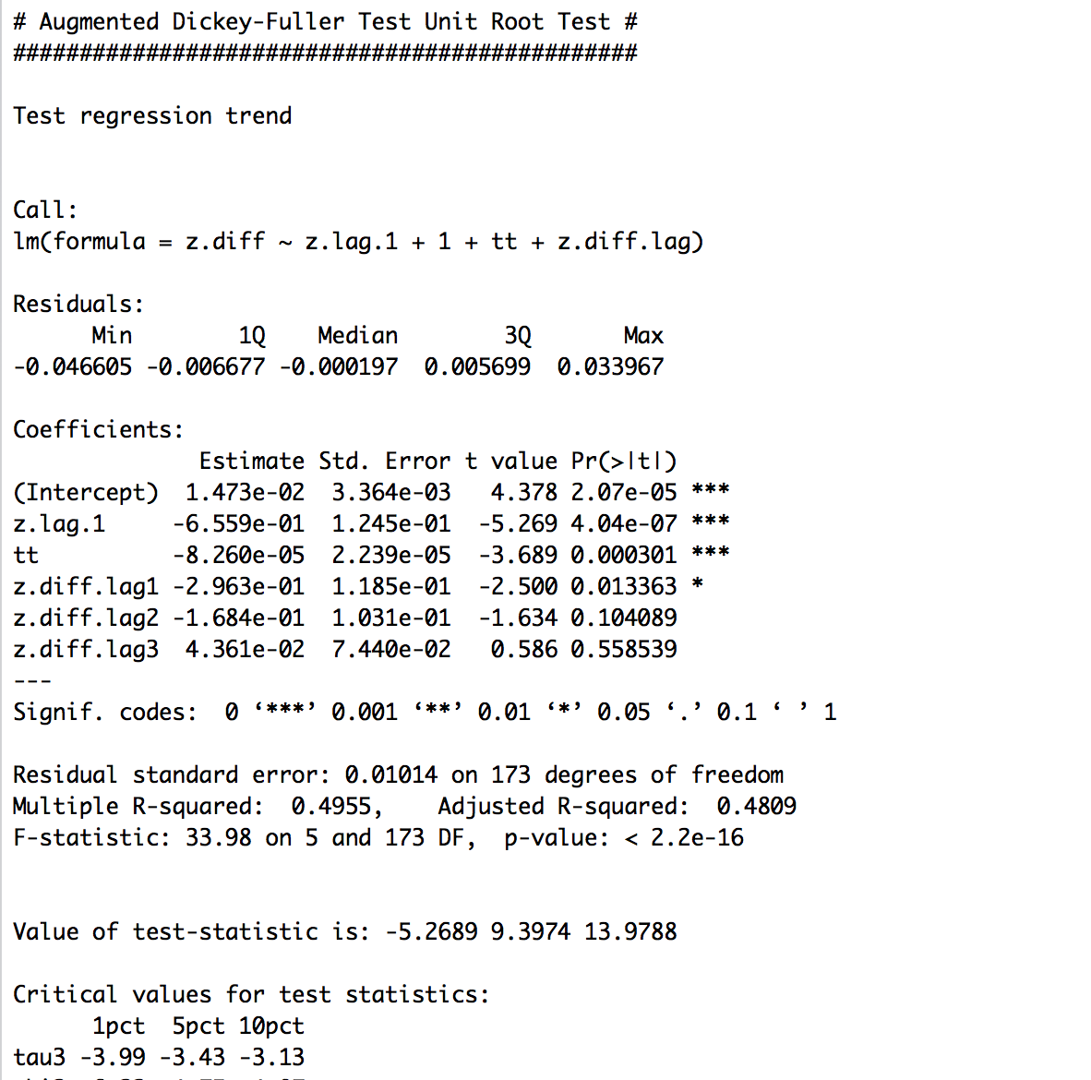
First difference
summary(ur.df(diff(gdpjp$lngdp,1),type="trend",lags=3))
Your turn: What can we conclude that lngdp series if integrated of order
0
1
2

Slide 47
An example: Orange Juice series
Frozen concentrated orange juice (FCOJ) is an important commodity
In the US prices are mainly driven by conditions in Brazil and Florida.
Suppose we want to understand the effect of freezing weather in Florida on prices to predict prices a couple of months down the line.
Oj.dta : Monthly data on prices and freezing degree days

Slide 48
Orange Juice prices
Does it look stationary?

Slide 49
Freezing in Florida
Does it look stationary?

Slide 50
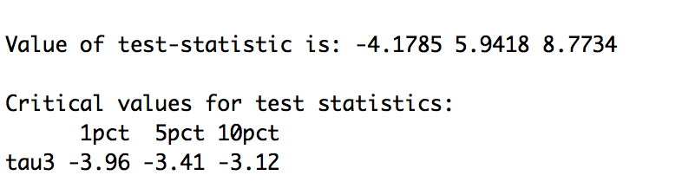
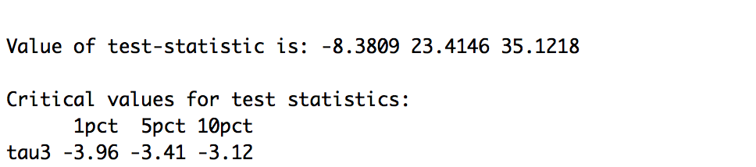
Dickey Fuller on OJ prices
oj <-read_dta("data/oj.dta")
oj["lnp"]=log(oj$ppioj/oj$pwfsa*100) summary(ur.df(oj$lnp,type="trend",lags=12))
Your turn: What can we conclude that is integrated of order
0
1
2
summary(ur.df(diff(oj$lnp,1),type="trend",lags=12))

Slide 51
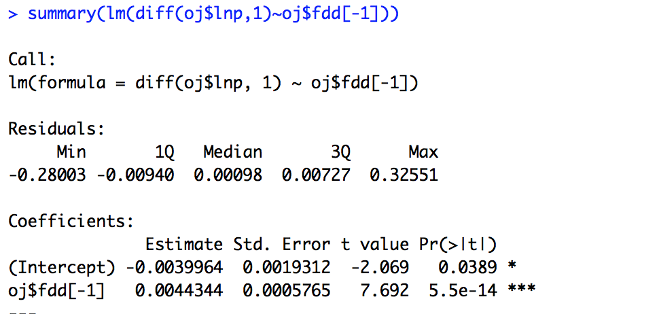
Simple regression
Note: only makes sense to run regressions once all involved variables are stationary
Otherwise we expose ourselves to potentially spurious results
1 extra freezing day leads 0.44% increase price

Slide 52
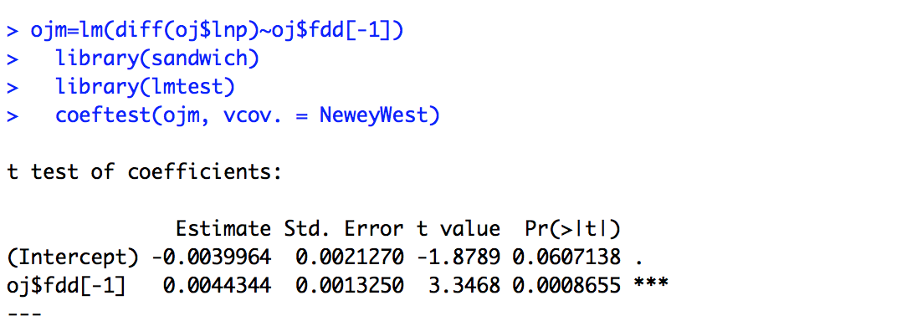
Price shocks correlated over time?
Standard errors become somewhat higher but yields similar picture in this case

Slide 53
Summary
Time series: Data points represent different observations in time of the same thing.
We need to worry about correlations between the datapoints
Key worry: things become non-stationary which does not leave us with something fixed to estimate over time
Hence, before starting the real analysis need to check if non-stationarity could be a problem
If so we have to make things stationary before doing the actual analysis
Methods for that
First differencing
Or by including a time trend
We focused on diff. because time trend does not help when in reality unit root whereas differ. is still ok when trend stationary case

